Slide 1
VuePoint Eye Comfort Study
Brad Thomas | 11/06/19

Slide 2
Eye Comfort Concept
The concept behind this test is that eye comfort is affected by three things
The luminous intensity
i.e. a 70,000 lumen light will hurt your eyes whether it is 2mm or 1m in diameter
This is not a parameter we can change because we must build luminaires at certain lumen levels
The size and contrast of pixilation within the light emitting area
A large diffuse light source is easy on the eyes, as long as it is not too bright
The same lumen output compacted into a smaller and smaller number of brighter and brighter spot sources with dark between them is uncomfortable to the eyes
This we have control over!
Patterns visible within the light emitting surface
Patterns catch your eye
Patterns with irregularities are more annoying than uniformity and symmetry
Irregular gaps like screw heads bother people
Make patterns as subdued and uniform as possible

Slide 3
Eye Comfort Equation
The Eye Comfort Equation is based on two factors
The relative size of the lighted source(s)
Calculate the solid angle in steradians that the lighted area subtends
This could be the bare LED, COB, lens, or diffuser area
The contrast ratio within the light emitting area
Probe the Radiant Imaging Camera file for the maximum and minimum Luminance within the output area of the light
The max/min ratio is the luminance contrast (LC)
The equation: 5/log(LC/Ω)
LC/Ω gets larger as the contrast goes up and angle goes down
Log function reduces it from over a billion to a 0-10 scale
5 over log(LC/Ωm) makes it a full scale of ~10 so that it can be related to the human subject voting on a scale of 5

Slide 4
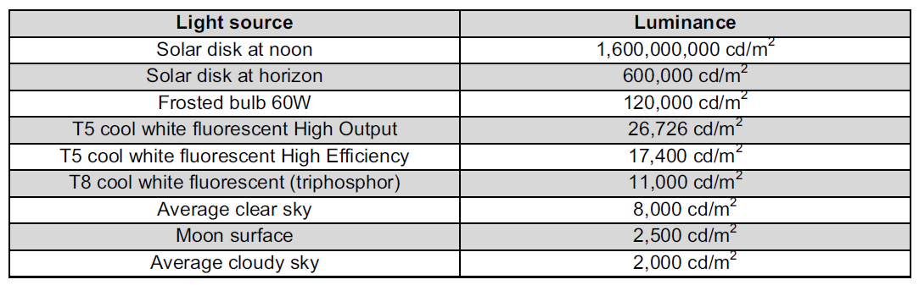
Luminance
Luminance is the measure of the amount of light emitted from a surface
Units are candelas per square meter
It is light at the source not on the target, so it is independent of distance
However, to measure it the radiant camera needs to know the lens focal length and distance to the source to calculate the area and therefore the Luminance

Slide 5
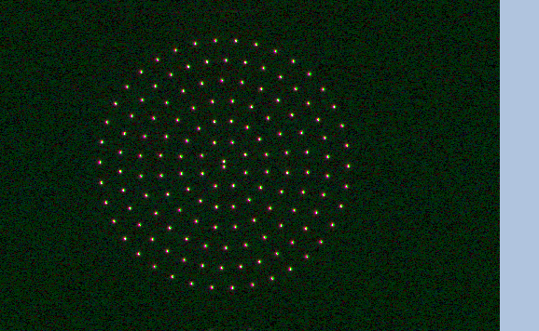
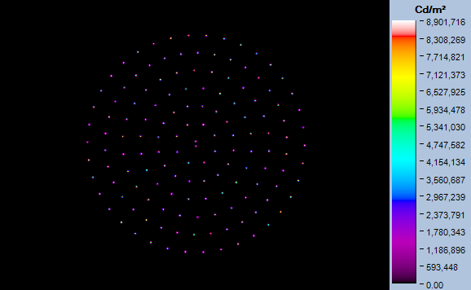
VuePoint with Bare LEDs
True Color
Luminance
LED 8,900,000 to space 2,000 is 4,450:1 ratio over 3mm span
Eye Comfort = 0.55

Slide 6
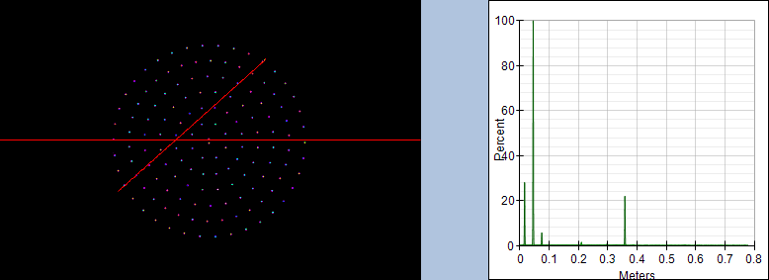
VuePoint with Bare LEDs - Luminance Profile
Extreme bright to dark contrast is uncomfortable to the eyes

Slide 7
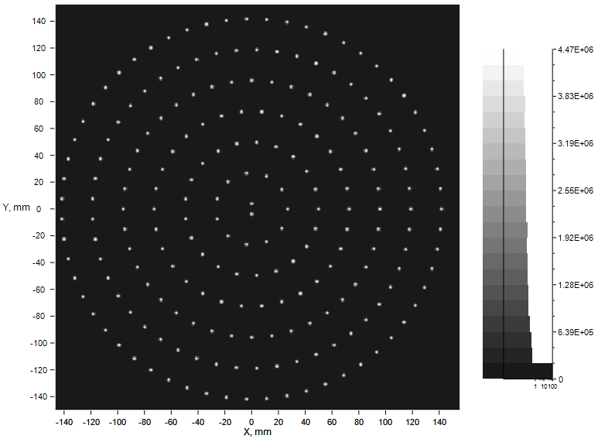
VuePoint with Bare LEDs – Light Tools Simulation
Luminance
LED 4,400,000 to space 800 is 5,500:1 ratio over 3mm span
Eye Comfort = 0.55

Slide 8
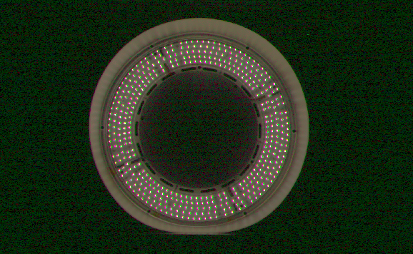
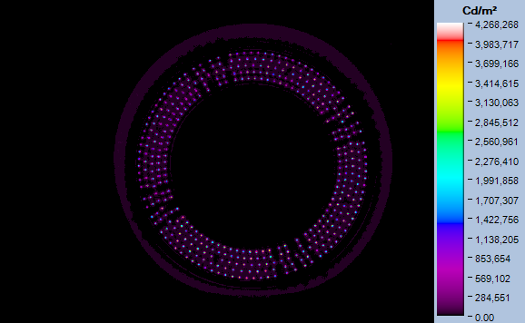
VuePoint P1 with Fresnel Lens
True Color
Luminance
LED 3,900,000 to space 3,000 is 1,300:1 ratio over 15mm span
Eye Comfort = 0.59

Slide 9
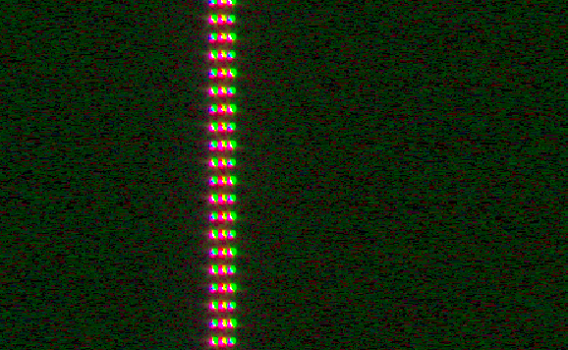

Flex without Lens
True Color
Luminance
LED 2,500,000 to space 2,500 is 1,000:1 ratio over 3mm span
Eye Comfort = 0.62

Slide 10
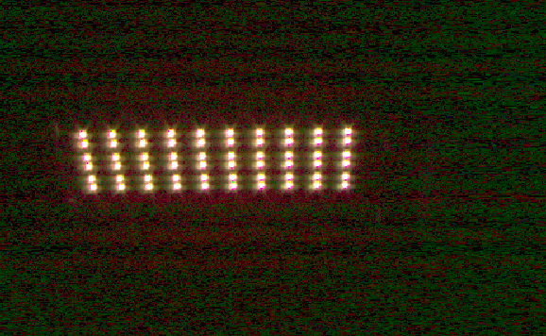
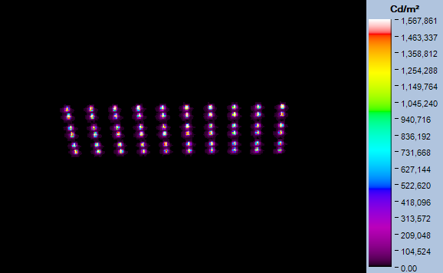
LEDway with 2M Optics
True Color
Luminance
LED 1,600,000 to space 2,000 is 800:1 ratio over 5mm span
Eye Comfort = 0.67

Slide 11
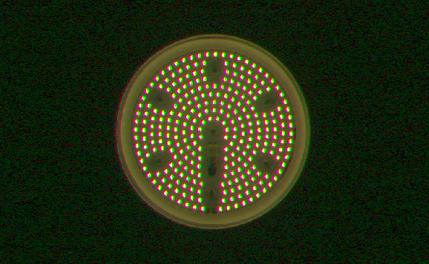
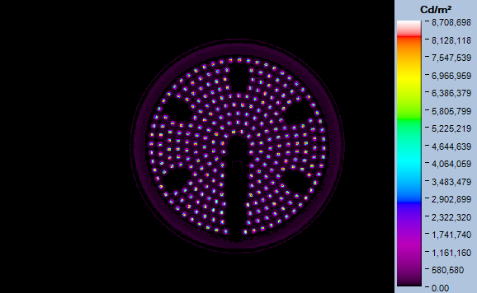
KBL-A (external Meanwell driver)
True Color
Luminance
LED 8,300,000 to space 30,000 is 277:1 ratio over 5mm span
Eye Comfort = 0.67

Slide 12
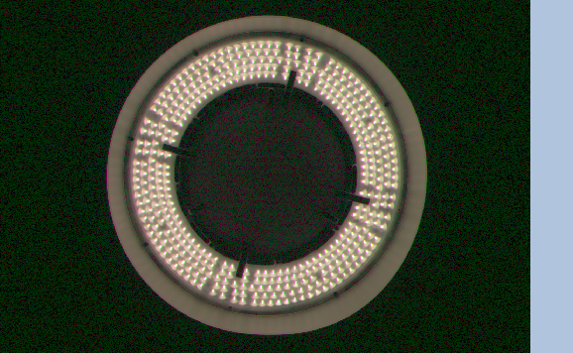
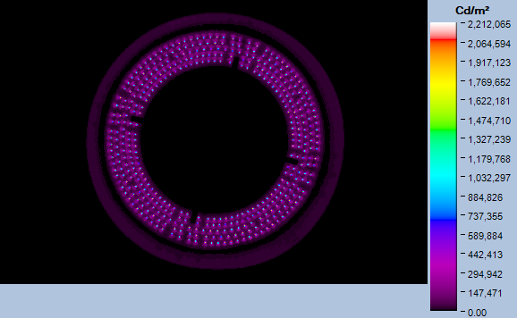
VuePoint P1 with Diffuser only
True Color
Luminance
LED 1,800,000 to space 2,500 is 720:1 ratio over 15mm span
Eye Comfort = 0.73

Slide 13
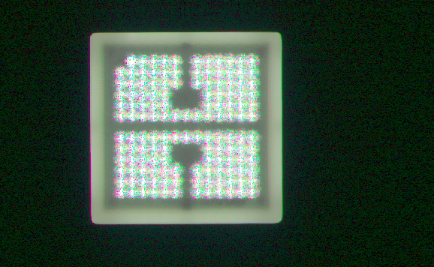
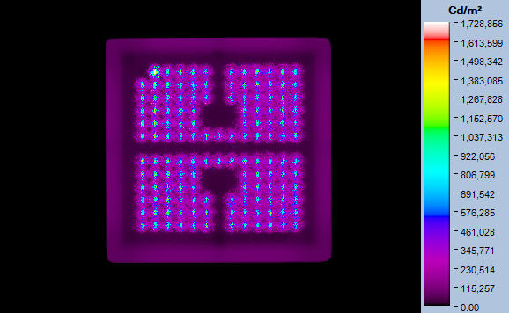
CPY 250 with Flat Lens
True Color
Luminance
LED 1,300,000 to space 30,000 is 43:1 ratio over 6mm span
Eye Comfort = 0.79

Slide 14
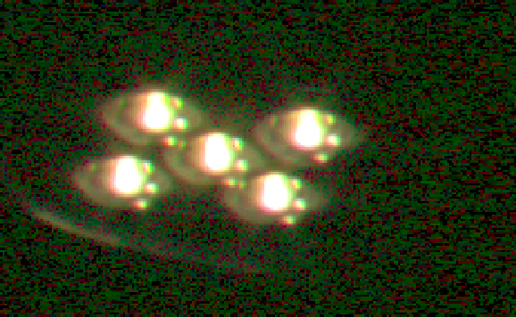
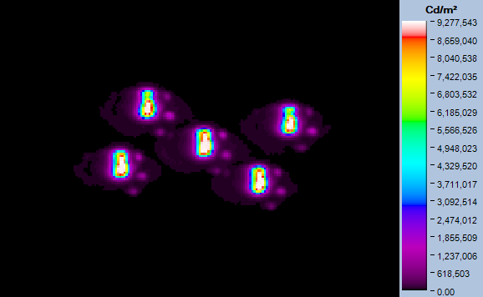
XSP 3ME
True Color
Luminance
LED 9,235,000 to space 45,000 is 205:1 ratio over 30mm span
Eye Comfort = 0.85

Slide 15
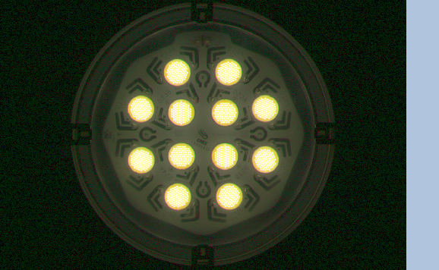
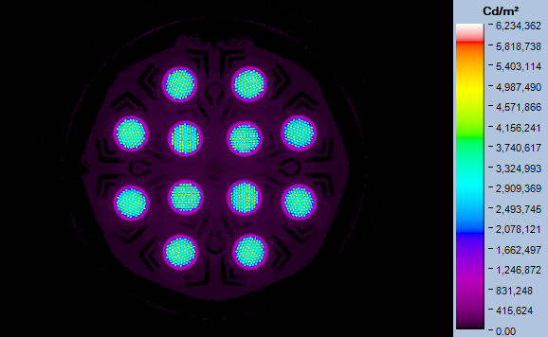
CXB-A
True Color
Luminance
LED 6,000,000 to space 45,000 is 133:1 ratio over 20mm span
Eye Comfort = 0.85

Slide 16
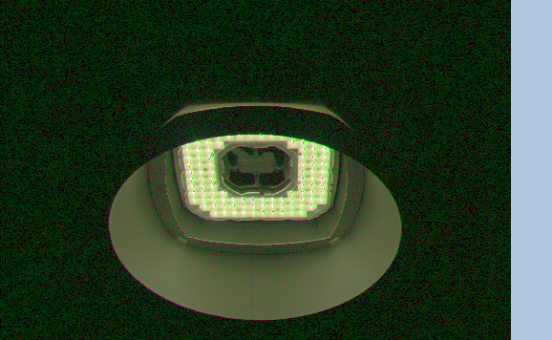
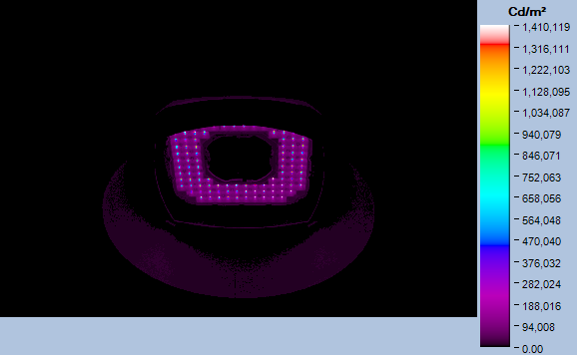
HXB 70kL Medium Optic at 65° Viewing Angle
True Color
Luminance
LED 1,400,000 to reflector 66,000 is 21:1 ratio over 26mm span
Eye Comfort = 0.95

Slide 17
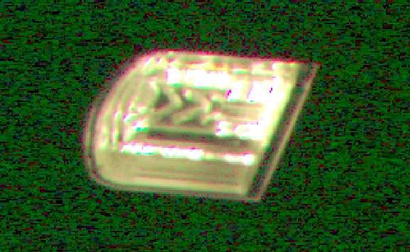
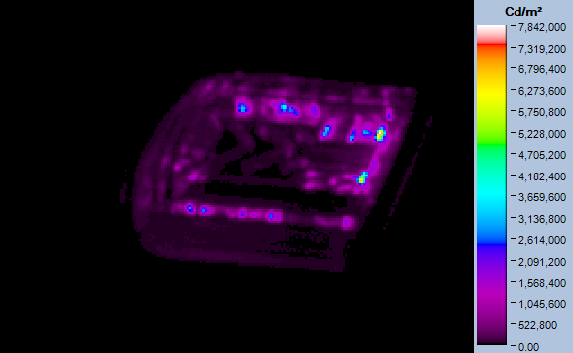
RSW Small 2ME (from slightly in front)
True Color
Luminance
Max 7,800,000 to space 8,000 is 975:1 ratio over 75mm span
Eye Comfort = 0.96

Slide 18
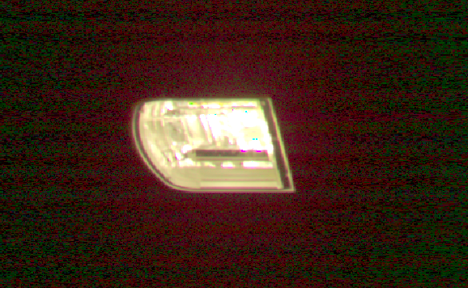
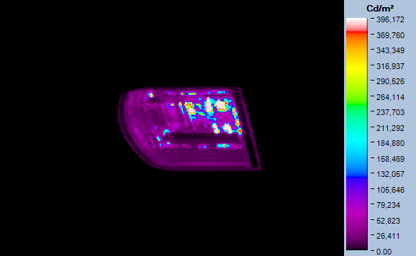
RSW Small (from slightly behind)
True Color
Luminance
Max 393,000 to space 13,000 is 30:1 ratio over 75mm span
Eye Comfort = 1.36

Slide 19
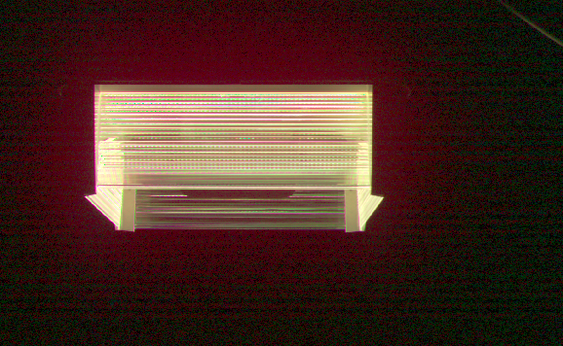
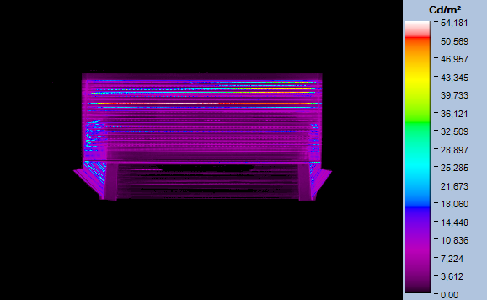
IG
True Color
Luminance
Max 50,000 to space 1,500 is 33:1 ratio over 125mm span
Eye Comfort = 1.47

Slide 20
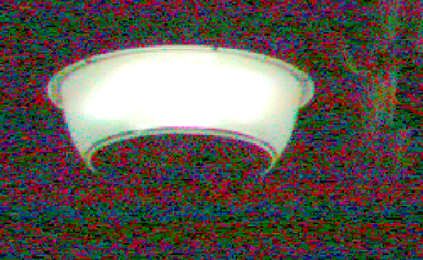
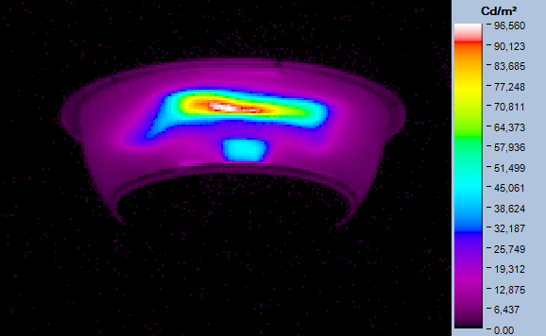
VG with narrow reflector
True Color
Luminance
Max 96,000 to space 4,000 is 24:1 ratio over 150mm span
Eye Comfort = 2.0

Slide 21
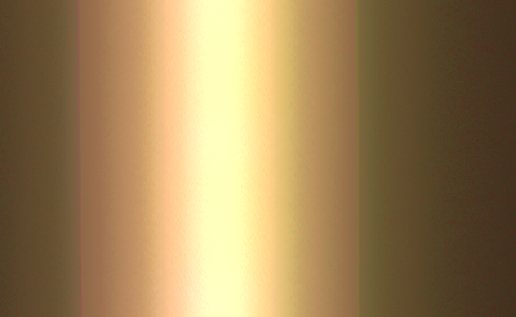
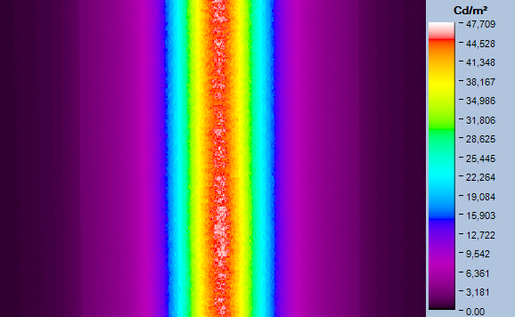
Flex with Lens
True Color
Luminance
LED 46,000 to diffuser edge 5,000 is 9:1 ratio over 100mm span
Eye Comfort = 2.05

Slide 22
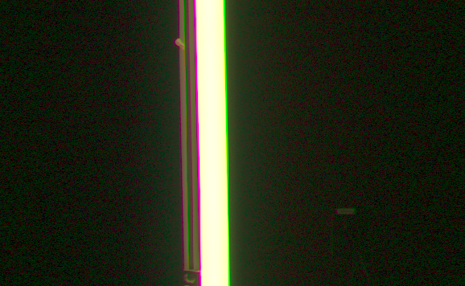
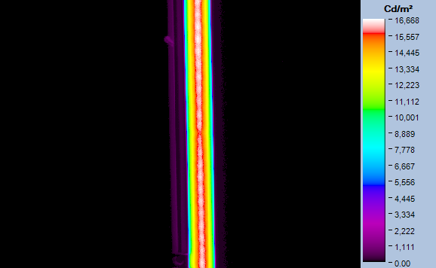
LS4 White Satin Ice at Nadir
True Color
Luminance
LED 16,400 to diffuser edge 9,000 is 1.8:1 ratio over 50mm span
Eye Comfort = 2.14

Slide 23
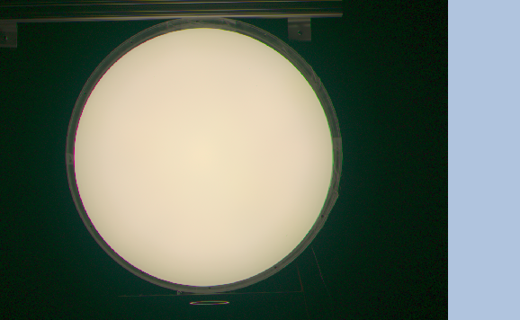
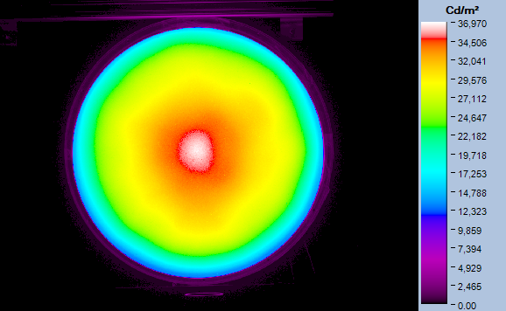
VuePoint with Diffuser
True Color
Luminance
Center 36,000 to edge 15,000 is 2.4:1 ratio over 230mm span
Eye Comfort = 3.3

Slide 24
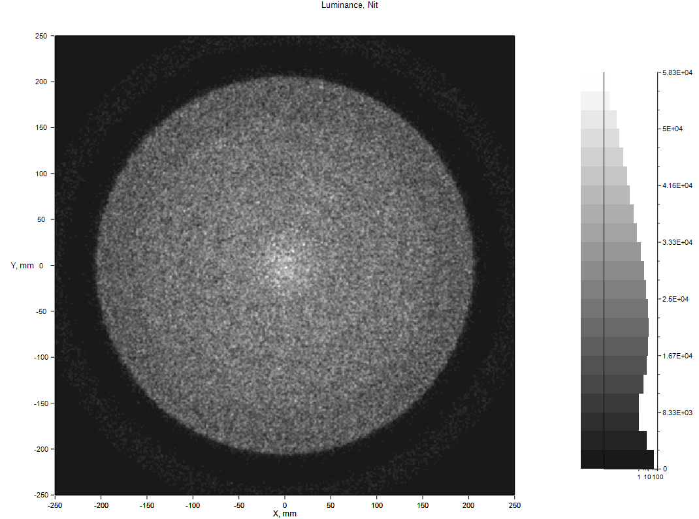
VuePoint with Diffuser
Luminance from Light Tools
Center 55,000 to edge 2,000 is 27.5:1 ratio over 230mm span
Eye Comfort = 1.9

Slide 25
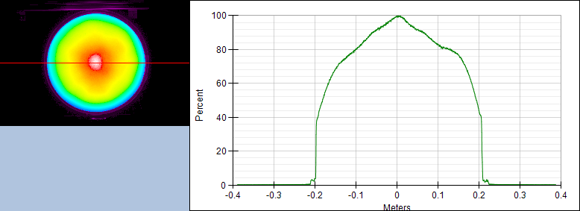
VuePoint with Diffuser - Luminance Profile
Gradual intensity transition is comfortable to the eyes

Slide 26
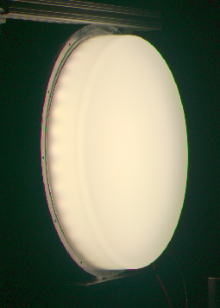
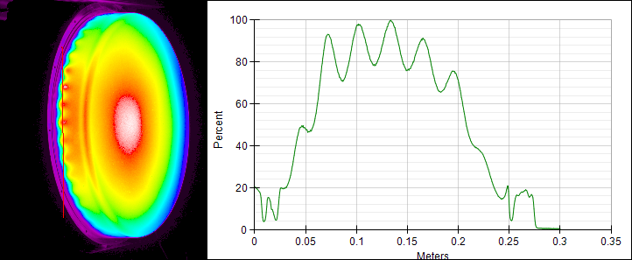
VuePoint 12kL Scalloped Edge Luminance
Scalloped pattern of intensity is not uncomfortable, but is annoying

Slide 27
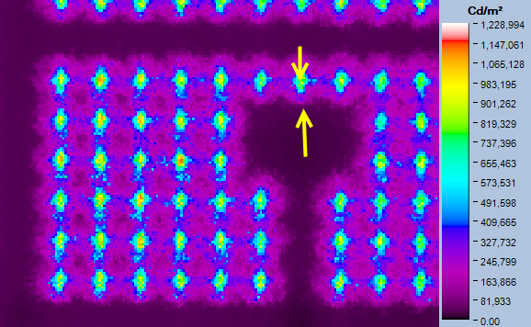
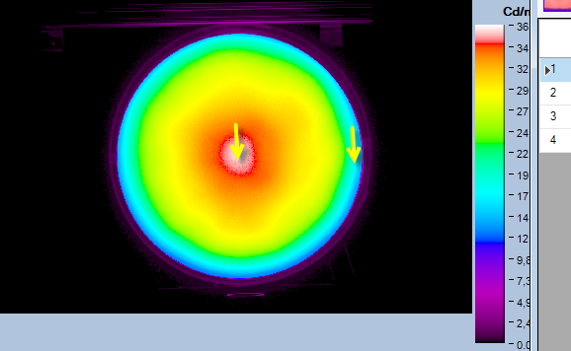
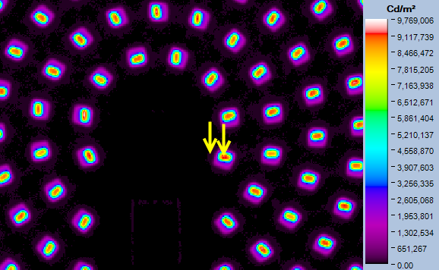
Measurement Method
CPY: 1.3M – 30K in 6mm
Radiant image files were probed manually to get a maximum luminance delta in the smallest distance
Numbers entered into the spreadsheet are a nominal high to nominal low, not the absolute max and min
VuePoint: 36K – 15K in 230mm
KBL: 8.3M – 30K in 5mm
KBL: 393K – 13K in 75mm

Slide 28
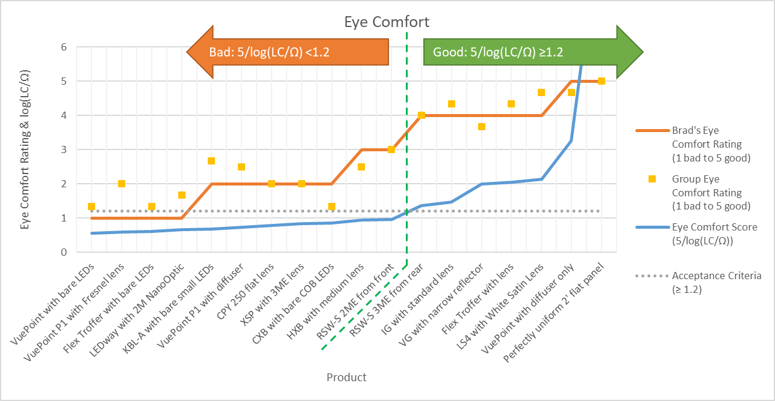
Eye Comfort Formula Graph
Group eye comfort rating is average of scores from:
Brad Thomas, Jon Vollers, Erik Milz, and Randy Bernard

Slide 29
Data for Eye Comfort Scores
Luminaire | Brad's Eye Comfort Rating (1 bad to 5 good) | Group Eye Comfort Rating (1 bad to 5 good) | Viewing Distance (ft) | Max-Min Separation (mm) | Area (sq ft) | Ω Solid Angle (Steradians) | Maximum Luminance (cd/m^2) | Minimum Luminance (cd/m^2) | Luminous Contrast: LC (Lmax/Lmin) | LC/Ω (luminous contrast / steradian) | Eye Comfort Score (5/log(LC/Ω))
VuePoint with bare LEDs | 1 | 1.33 | 20 | 3 | 0.0000761 | 0.0000038 | 8,900,000 | 2,000 | 4450 | 1.17E+09 | 0.55
VuePoint P1 with Fresnel lens | 1 | 2.00 | 20 | 3 | 0.0000761 | 0.0000038 | 3,900,000 | 3,000 | 1300 | 3.42E+08 | 0.59
Flex Troffer with bare LEDs | 1 | 1.33 | 10 | 3 | 0.0000761 | 0.0000076 | 2,500,000 | 2,500 | 1000 | 1.31E+08 | 0.62
LEDway with 2M NanoOptic | 1 | 1.67 | 30 | 10 | 0.0008454 | 0.0000282 | 1,600,000 | 2,000 | 800 | 2.84E+07 | 0.67
KBL-A with bare small LEDs | 2 | 2.67 | 20 | 5 | 0.0002113 | 0.0000106 | 8,300,000 | 30,000 | 277 | 2.62E+07 | 0.67
VuePoint P1 with diffuser | 2 | 2.50 | 20 | 15 | 0.0019021 | 0.0000951 | 1,800,000 | 2,500 | 720 | 7.57E+06 | 0.73
CPY 250 flat lens | 2 | 2.00 | 15 | 6 | 0.0003043 | 0.0000203 | 1,300,000 | 30,000 | 43 | 2.14E+06 | 0.79
XSP with 3ME lens | 2 | 2.00 | 30 | 30 | 0.0076086 | 0.0002536 | 9,235,000 | 45,000 | 205 | 8.09E+05 | 0.85
CXB with bare COB LEDs | 2 | 1.33 | 20 | 20 | 0.0033816 | 0.0001691 | 6,000,000 | 45,000 | 133 | 7.89E+05 | 0.85
HXB with medium lens | 3 | 2.50 | 50 | 26 | 0.0057149 | 0.0001143 | 1,400,000 | 66,000 | 21.2 | 1.86E+05 | 0.95
RSW-S 2ME from front | 3 | 3.00 | 30 | 150 | 0.1902140 | 0.0063405 | 7,800,000 | 8,000 | 975 | 1.54E+05 | 0.96
RSW-S 3ME from rear | 4 | 4.00 | 30 | 150 | 0.1902140 | 0.0063405 | 393,000 | 13,000 | 30.2 | 4.77E+03 | 1.36
IG with standard lens | 4 | 4.33 | 10 | 125 | 0.1320931 | 0.0132093 | 50,000 | 1,500 | 33 | 2.52E+03 | 1.47
VG with narrow reflector | 4 | 3.67 | 10 | 300 | 0.7608560 | 0.0760856 | 96,000 | 4,000 | 24 | 3.15E+02 | 2.00
Flex Troffer with lens | 4 | 4.33 | 10 | 200 | 0.3381582 | 0.0338158 | 46,000 | 5,000 | 9.2 | 2.72E+02 | 2.05
LS4 with White Satin Lens | 4 | 4.67 | 10 | 100 | 0.0845396 | 0.0084540 | 16,400 | 9,000 | 1.8 | 2.16E+02 | 2.14
VuePoint with diffuser only | 5 | 4.67 | 20 | 406 | 1.394 | 0.070 | 36,000 | 15,000 | 2.4 | 3.44E+01 | 3.25
Perfectly uniform 2' flat panel | 5 | 5.00 | 10 | 609 | 3.135 | 0.314 | 20,000 | 20,000 | 1 | 3.19E+00 | 9.93

Slide 30
Cylon Study

Slide 31
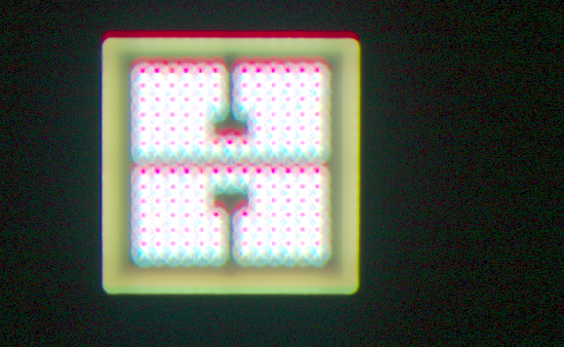
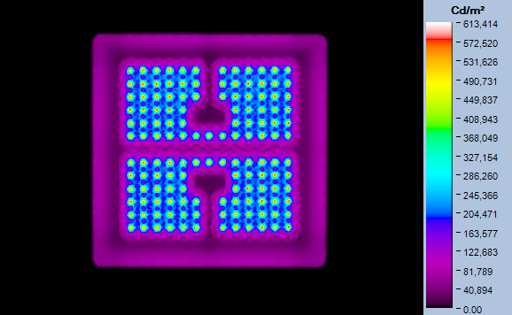
CPY 250 with Flat Lens
Cylon Study
True Color
Luminance
LED 565,000 to space 20,000 is 28:1 ratio over 6mm span
Eye Comfort = 0.81

Slide 32
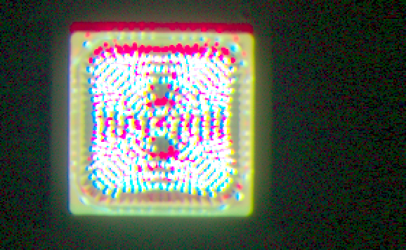
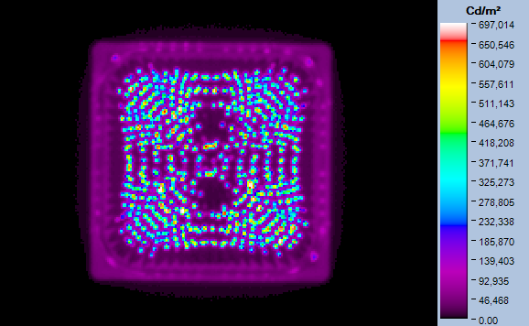
CPY 250 with Drop Lens
Cylon Study
True Color
Luminance
LED 627,000 to space 15,000 is 42:1 ratio over 4mm span
Eye Comfort = 0.75

Slide 33
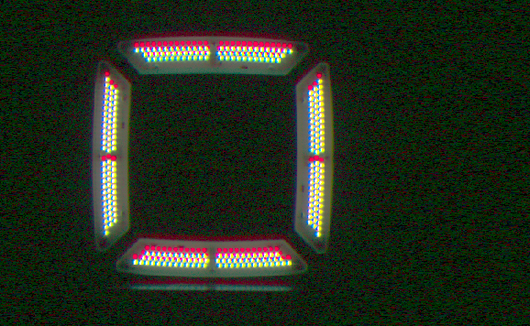
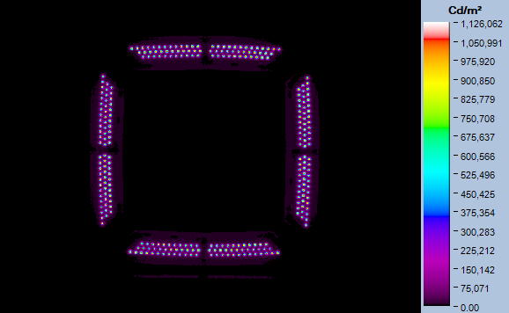
LSI Scottsdale Vertex
Cylon Study
True Color
Luminance
LED 1,022,000 to space 10,000 is 102:1 ratio over 4mm span
Eye Comfort = 0.71

Slide 34


Jarvis Xbeam
Cylon Study
True Color
Luminance
LED 8,000,000 to space 20,000 is 400:1 ratio over 25mm span
Eye Comfort = 0.83

Slide 35

Eye Comfort Formula Graph with Cylon Data
Group eye comfort rating is average of scores from:
Brad Thomas, Jon Vollers, Erik Milz, and Randy Bernard

